Slide 1
Measuring Planck’s Constant by Observation of the Photoelectric Effect

Slide 2
Theory
Photoelectric Effect: Electrons can be ejected from a metal irradiated by electromagnetic radiation.
Increased frequency: increased electron kinetic energy
Albert Einstein: light is made of particles called photons
Increased intensity: more photons, same energy per photon

Slide 3
Experiment
Irradiate a metal cathode with light of a known frequency and measure the produced photocurrent
Vary the voltage between cathode and anode to find the stopping potential.
Repeat for several wavelengths of light.
Should satisfy the equation:
|V_{s}| = (hc/e) (1/λ) - Φ/e

Slide 4
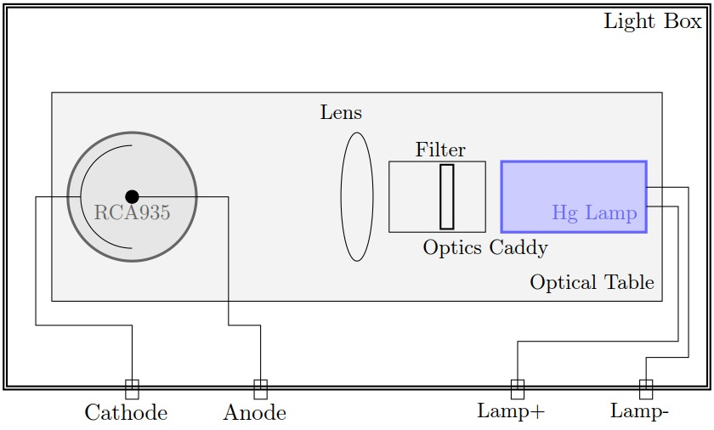
Experimental Setup

Slide 5
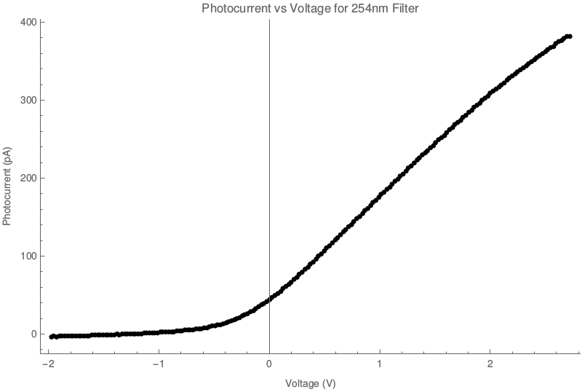
Current Vs. Voltage Graph

Slide 6
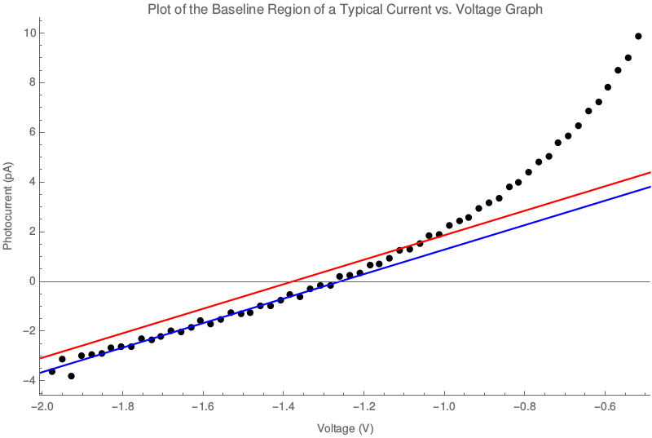

Slide 7
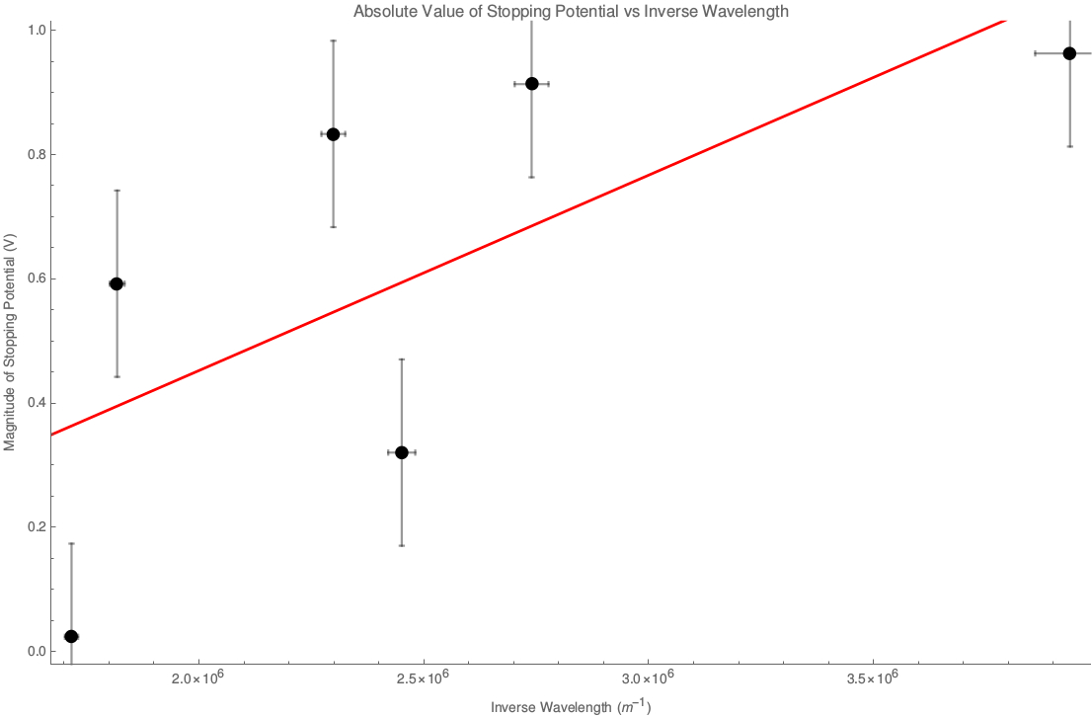
Results
Best fit line: |V_{s}| = (3.1 × 10⁻⁷ ± 0.8 × 10⁻⁷ Vm) (1/λ) - (0.2 ± 0.2 V)
h = 1.6 × 10⁻³⁴ ± 0.4 × 10⁻³⁴ Js
Φ = 0.2 ± 0.2 eV

